Slide 1







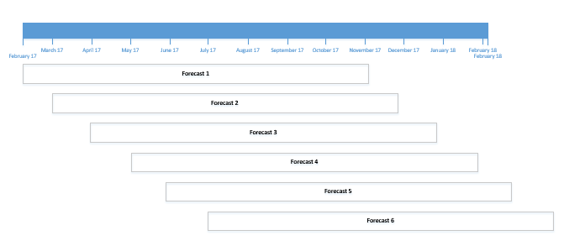
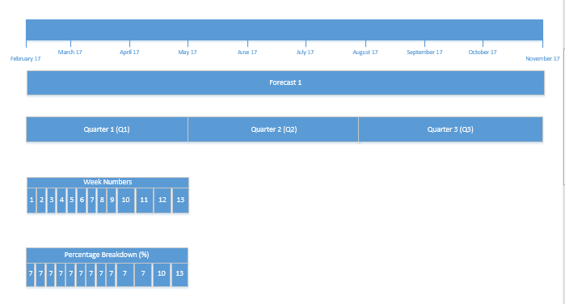
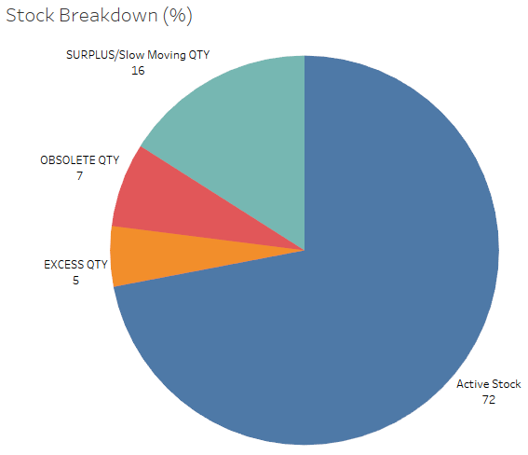
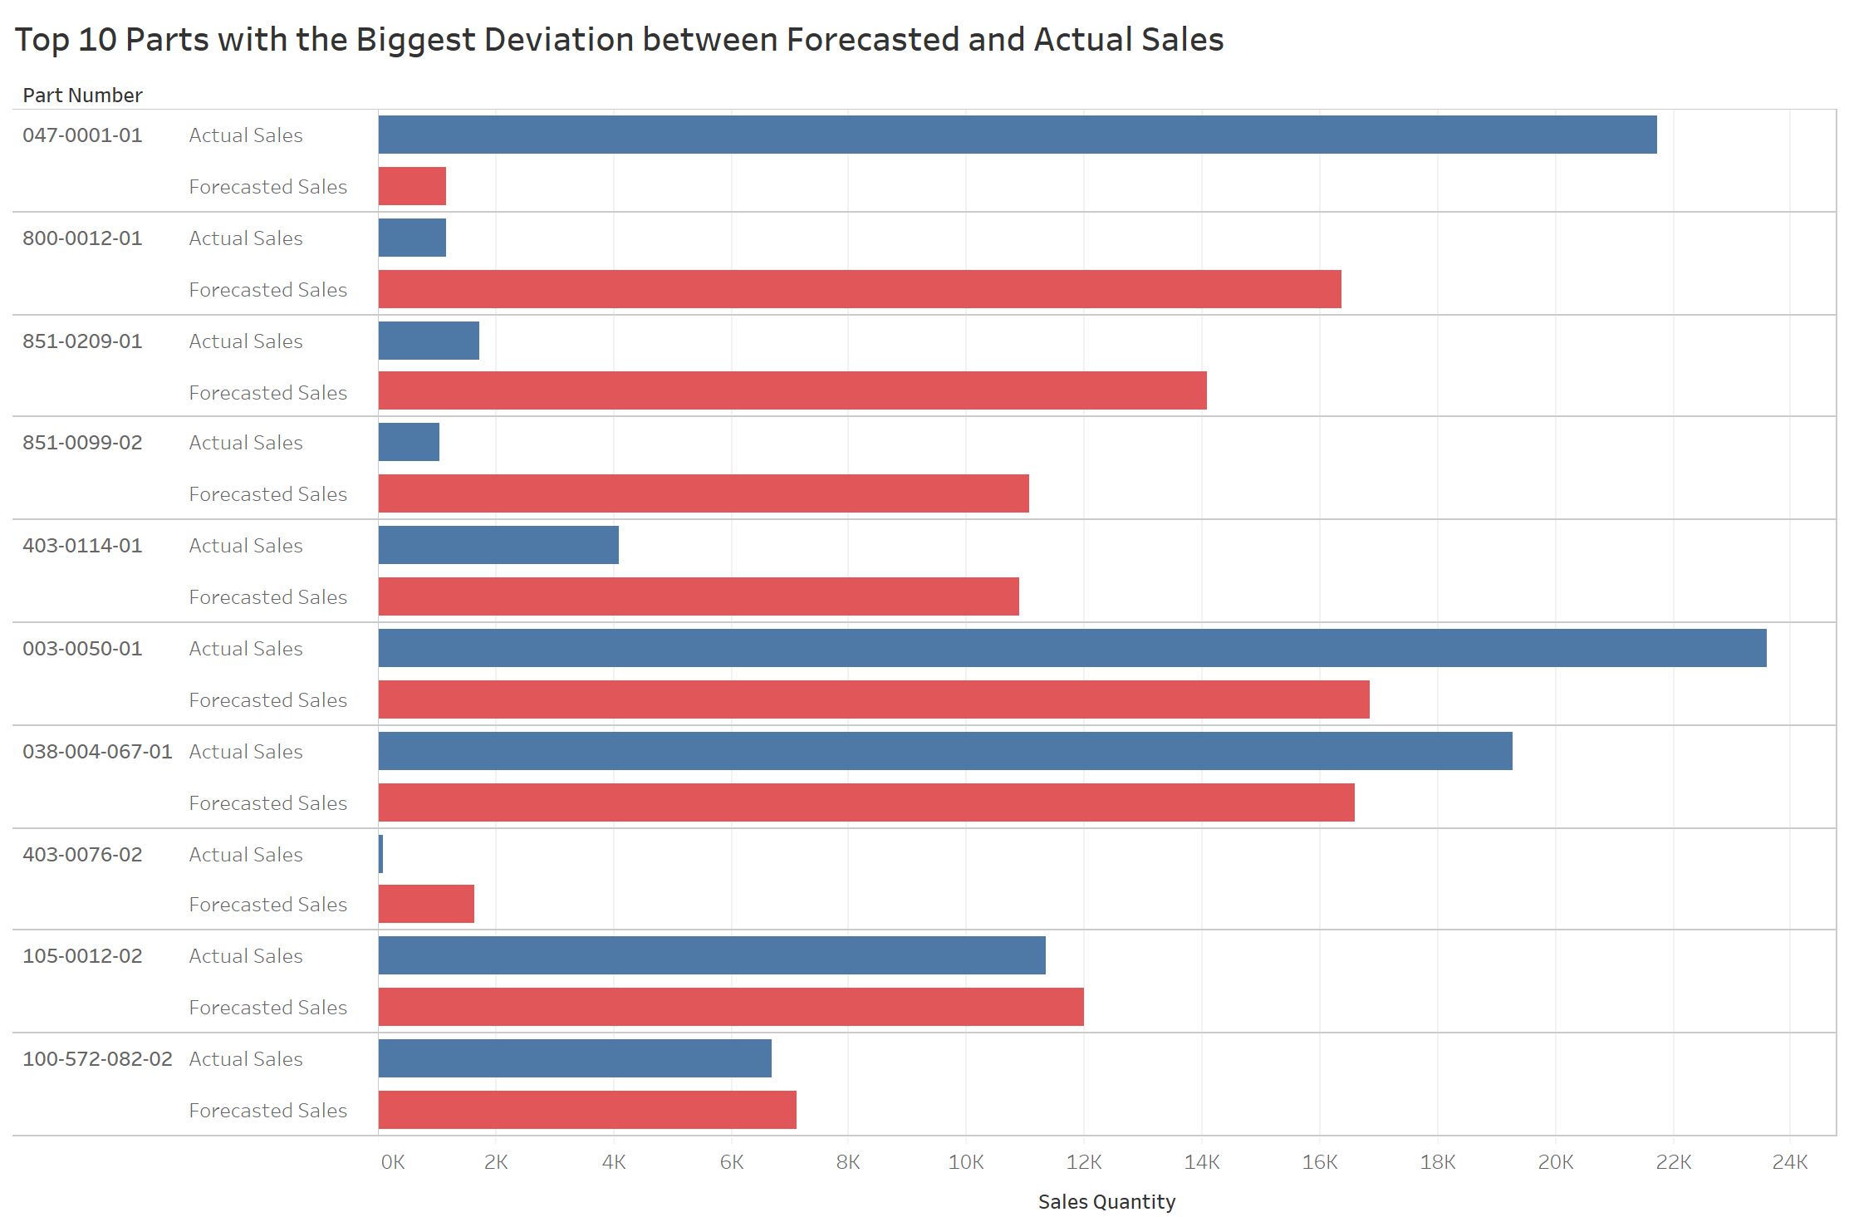
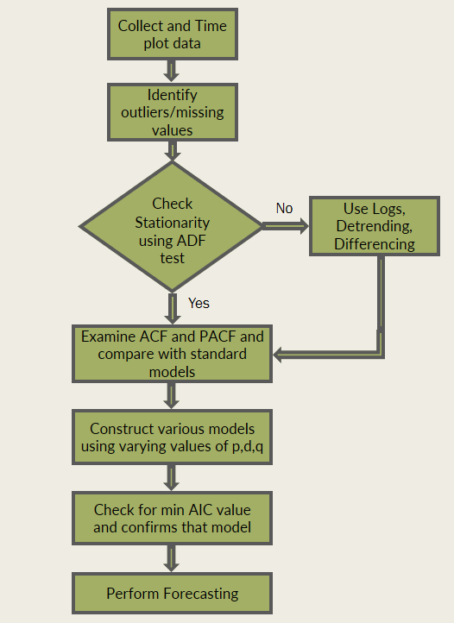
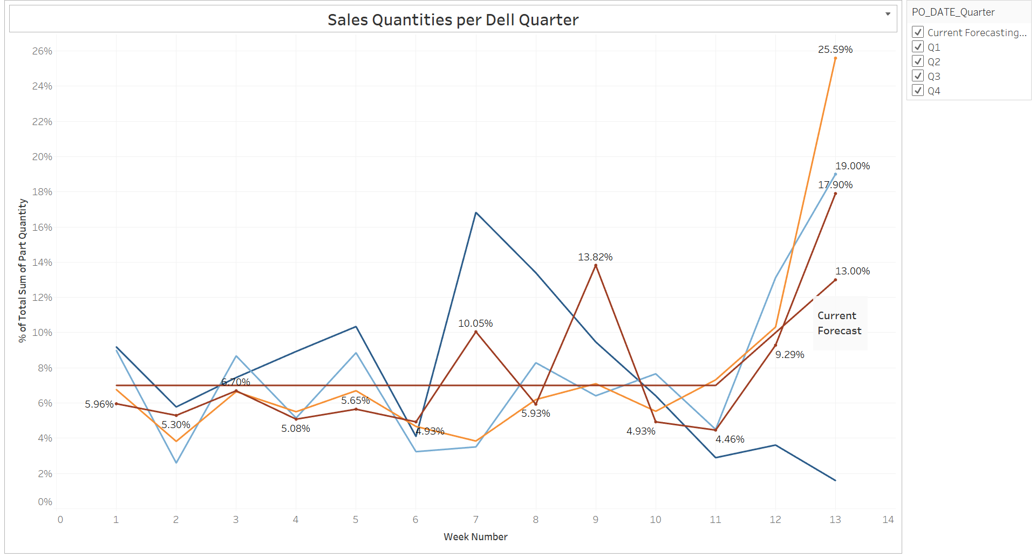
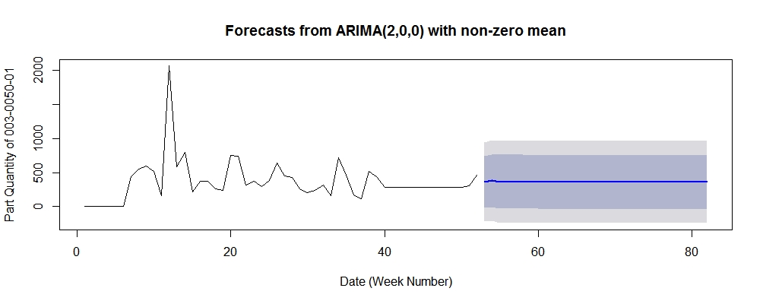


How Analytics Can Be Used To Drive Improved Supply Chain And Production Performance
Project Overview
The current sales forecasting model used by Celestica results in several negative outcomes. If sales are over-estimated, products are manufactured that end up outdated and no longer saleable, and obsolete raw materials become unprofitable while still occupying space in the warehouse. If sales are under-estimated, the production operations can be disrupted putting pressure on the operators to manufacture product within a short period of time.
There is also an opportunity cost meaning the money tied up in the excess inventory could have been invested elsewhere that would make a higher return.
Analytics can provide valuable insight to aid the management of complex supply chains and to minimize disruptions on production operations. It can provide greater transparency into the supply chains and enable decision makers to optimize the process.
Celestica’s Galway site does not have a strong presence of supply chain analytics, creating an opportunity for us to apply our knowledge and skills to a real-life context.
Tools & Techniques
Project Analysis
Forecasting Model Forecast Explanation
Stock Breakdown
Data Cleansing Process
Top Critical Parts
The Forecasting Process
Group Sales per part for each week
Master file for all possible part number
Pull weekly sales and forecasts for each part number
Aggregated Sales and Forecast File
Predictive Model in R
Time Series Analysis of Sales per Quarter
Recommendations and Conclusion
Our initial data cleansing and preparation highlighted the presence of data silos in the company and the need for a more integrated approach for data management. This integration would contribute towards real-time analysis and visibility. Our analysis of the top critical parts brings attention to the component parts that are causing most forecasting problems for Celestica and shows how much the forecasting inaccuracies are costing Celestica.
We recommend for Celestica to adjust their current forecasting model to reflect the fluctuations in week numbers 1-6 and to increase the weighting of the percentage breakdown for week number 13 to reflect the increase in end-of-quarter sales. Celestica are loosely meeting their inventory management targets, however the level of obsolete material is exceeding the target by 4%.
Group Members: Sughosh Harve, Tanay Chowdhury,
Sinead Jacobsen, Sazel Khokhar
Project Supervisor: Prof. Willie Golden

